Slide 1
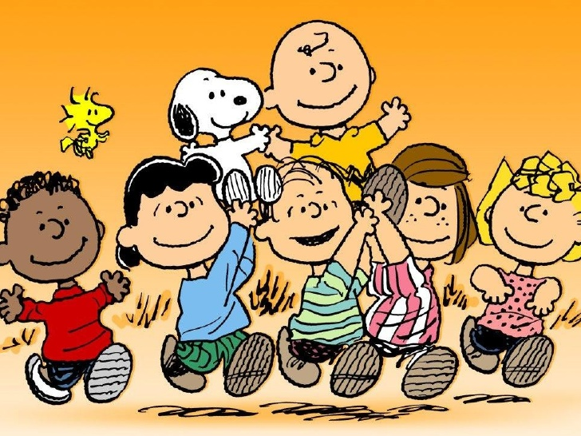
The Top 10 Lessons I Learned from Charlie Brown

Slide 2
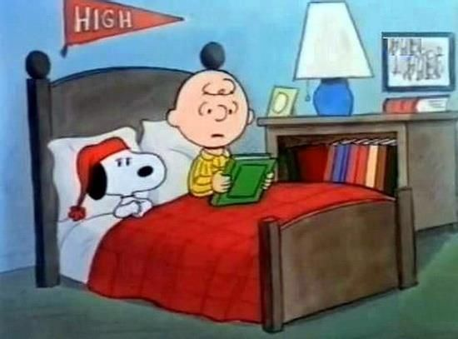
1. It’s okay to be afraid… just don’t let your fears control you.
Charlie Brown often sat in bed and spoke of his fears, but no matter how scared he was he always did the things he wanted to do.

Slide 3
Assignment B
B. 1. What are some of your fears? Which one, if any, is holding you back?

Slide 4
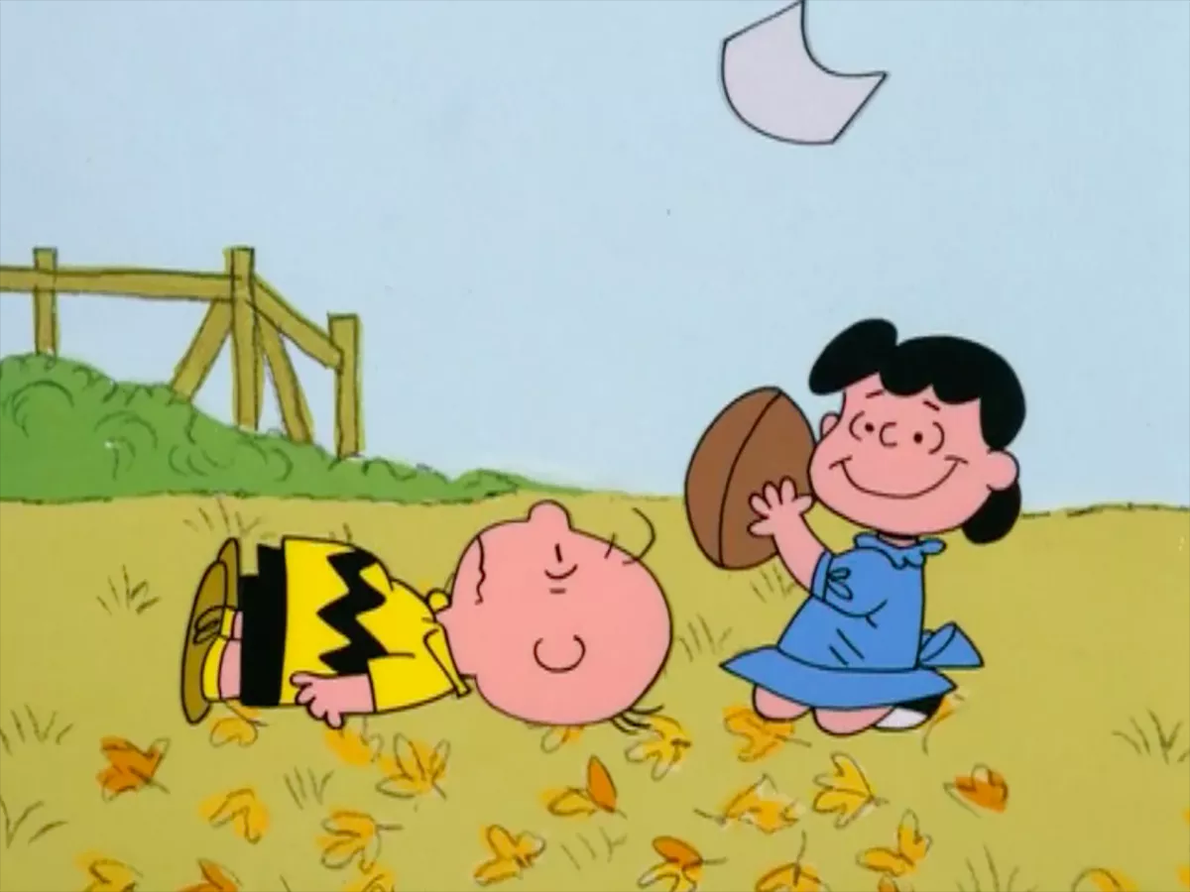
2. Persistence wins out.
Charlie Brown often lost, failed at much, but he never gave up. Even though he knew Lucy was going to pull the football away before he could kick it.... Even though he knew the tree was going to eat his kite... Even though he knew his team would lose the ball game… he kept on trying.

Slide 5
Assignment B
B. 2. Tell about a time that you refused to give up.

Slide 6
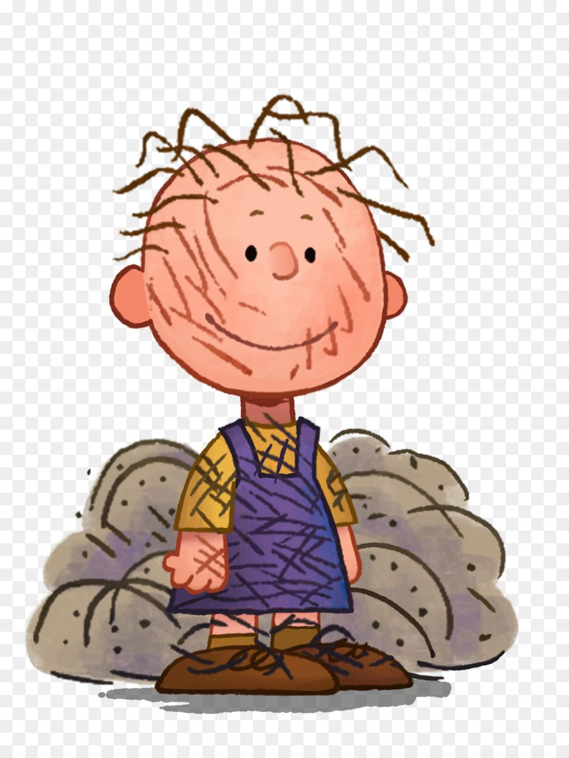
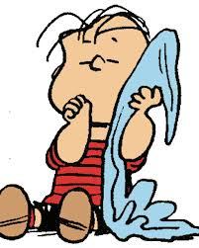
3. It’s what you think of yourself that counts.
Linus carried a security blanket for years and his friends laughed at him. They also laughed at him because he believed in the Great Pumpkin. Pigpen was a walking cloud of dust and dirt and was often regarded unkindly. Both characters, however, were always proud of themselves and believed they were as good as anybody else – and they were right.

Slide 7
Assignment B
B. 3. What do you think about yourself at this very moment?

Slide 8
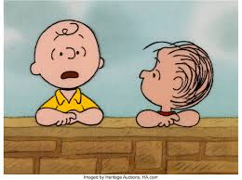
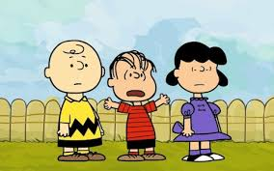
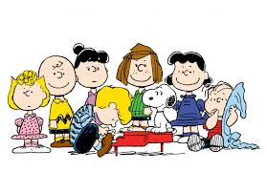
4. Sometimes you need to talk.
One thing the “Peanuts” gang understood was the importance of talking things out. Whether leaning up against Schroeder’s piano or atop the brick wall, they always discussed what was of concern to them.

Slide 9
Assignment B
B. 4. Who do you turn to when you need to talk? Do you have a special place that you like to go?

Slide 10
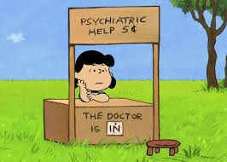
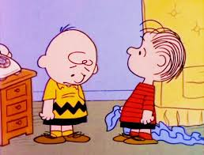
5. Sometimes you need to listen.
Even crabby, self-indulged Lucy knew the importance of listening. She started the famous Psychiatry Booth where any and all could come and be heard.

Slide 11
Assignment B
B. 5. What makes you a good listener?

Slide 12
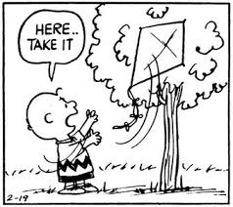
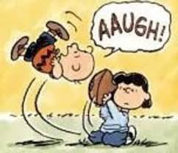
6. Do what you love to do.
Through all their adventures, Schroeder remained constant in his appreciation of Beethoven and his love of playing the piano. He loved to play piano and that’s what he did, regardless of the circumstances. Charlie Brown flew his kite, played baseball and football, not just to win (he knew he wouldn’t), but because he loved to do those things.

Slide 13
Assignment B
B. 6. What are 3 things you love to do?

Slide 14
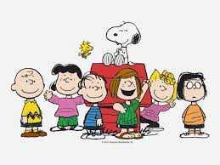
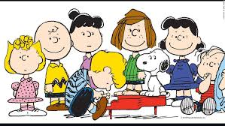
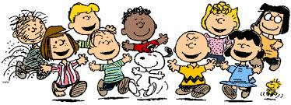
7. It’s important to have friends that care.
The Peanuts gang was made up of individual characters, each with their own foibles and talents, but through it all they were always there for each other.

Slide 15
Assignment B
B. 7. Who are the friends that you know care about you? How do you know they care about you?

Slide 16
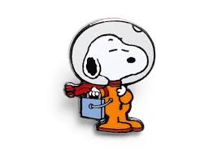
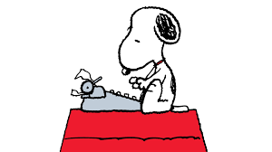
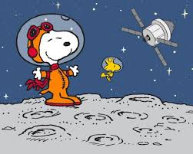
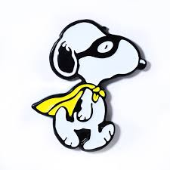
8. Big dreams lead to big things.
Snoopy was the biggest dreamer of them all, but his wild imagination often led to even wilder, more fantastic adventures in real life. Snoopy knew that you must have a big dream if you are going to lead a big life.

Slide 17
Assignment B
B. 8. What are your two biggest dreams?

Slide 18
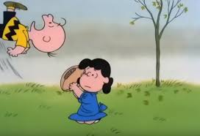
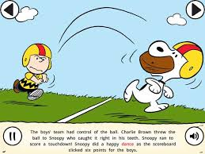
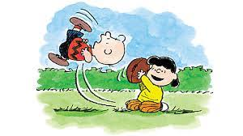
9. Action creates reality.
As Charlie Brown was reminded time and again after prodding from Linus: it takes action to bring about change. Though he often failed, Chuck took action quite regularly – and every now and again things would go his way.

Slide 19
Assignment B
B. 9. Tell about a time that you took action and it paid off.

Slide 20
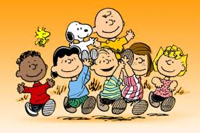
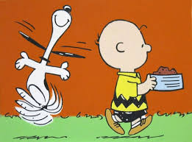
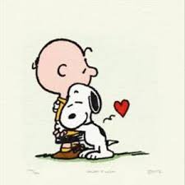
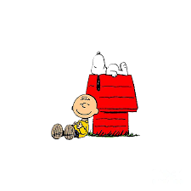
10. Laugh every day.
While the kids themselves may not have seen the humor in the things they did, Schulz made sure that we did. Life is only as serious or as humorous as YOU make it. Lighten up. Go play softball. Fly a kite. Dance with your dog. Smile... it makes people wonder what you’re up to.

Slide 21
Assignment B
B. 10. What three things make you laugh?

